Slide 1
CPU Scheduling Simulator
CPCS361 - Operating System Project

Slide 2
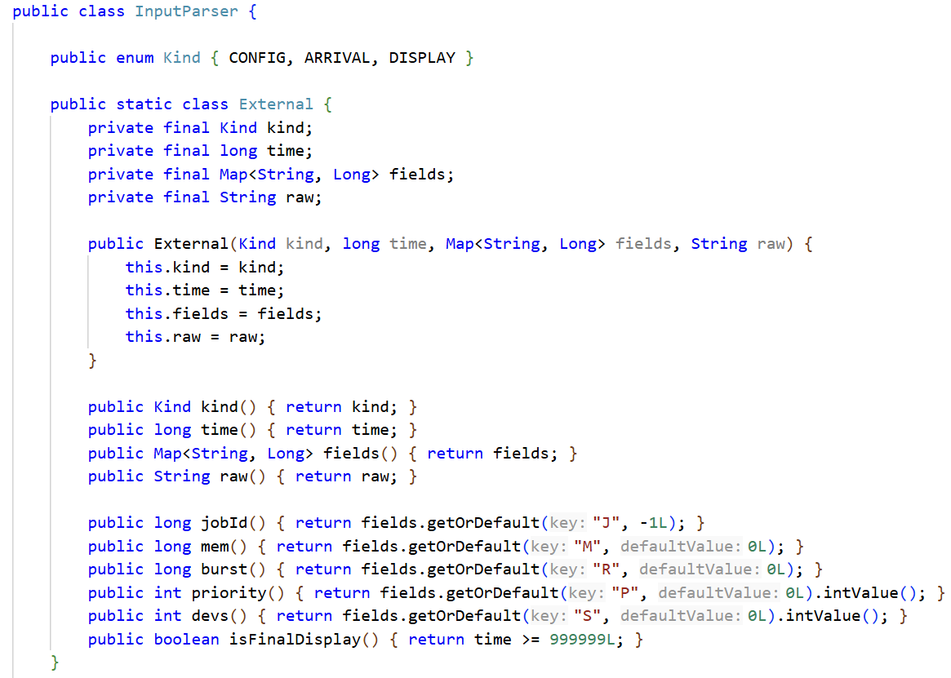
Input specification
Correct System Configuration
1. Correct System Configuration
2. Valid input for Jobs

Slide 3
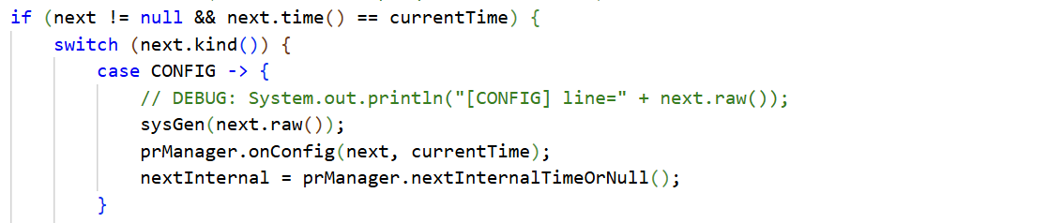
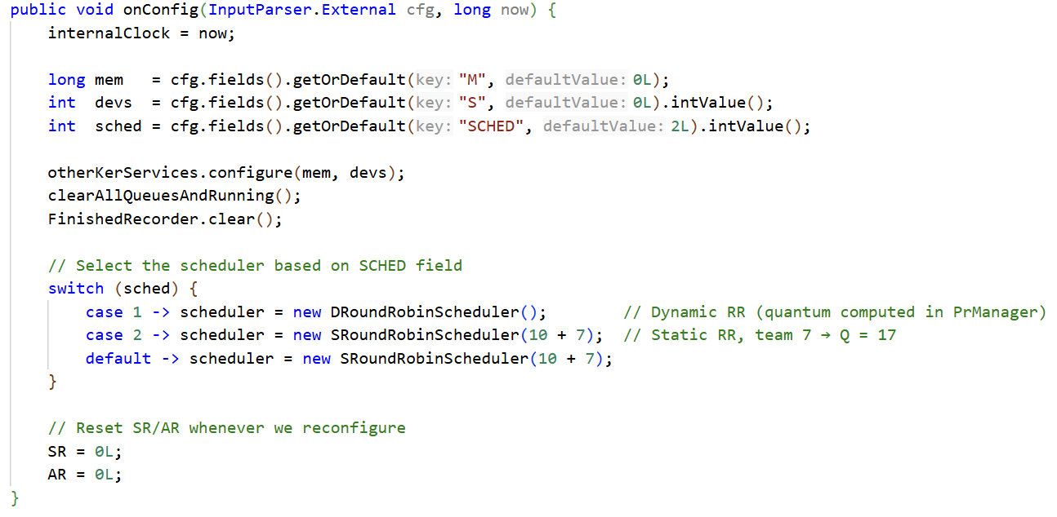
Input specification
Valid input for Jobs
1. Correct System Configuration
2. Valid input for Jobs

Slide 4
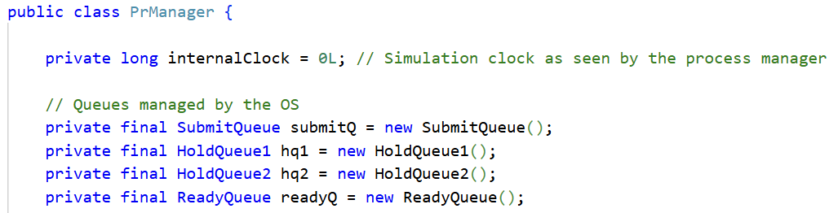
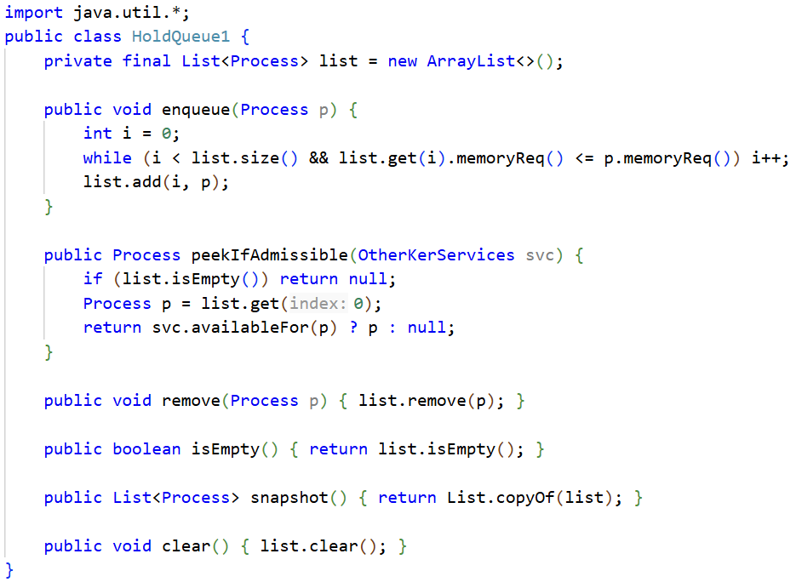
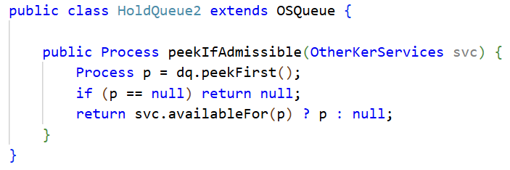
Implementation of queues
1. Implementation of the Hold Queue 1 by memory ascending order scheduling algorithm.
2. Implementation of the Hold Queue 2 with First Come First Serve scheduling algorithm.
3. Implementation of the Ready Queue with First In First Out scheduling algorithm .

Slide 5
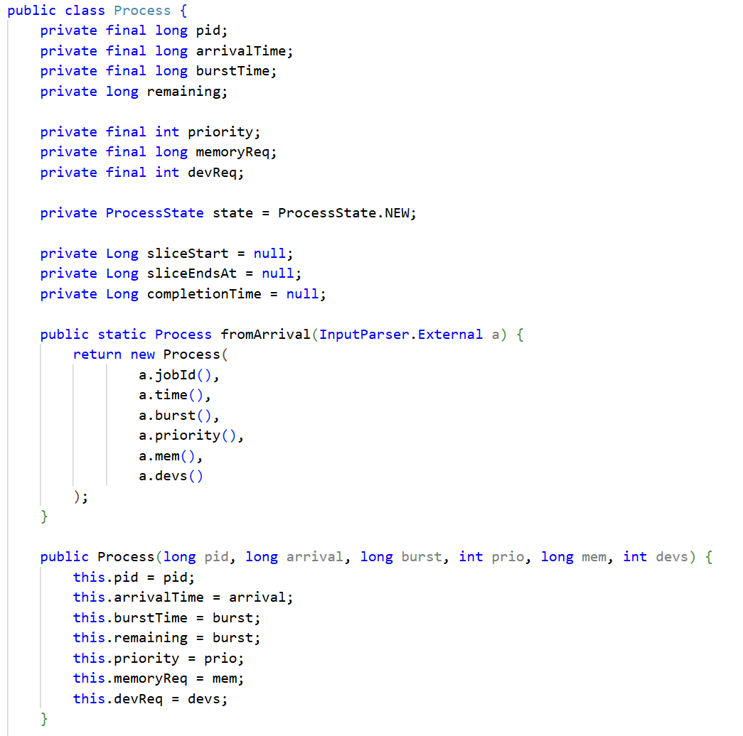
Required Data
Implementation of a data structure for Jobs.
1. Implementation of a data structure for Jobs
2. Implementation of a data structure for Processes
3. Start reading the external event, assuming the internal event is null (infinity).
4. Declare the variable "current time".
Implementation of a data structure for Processes.

Slide 6
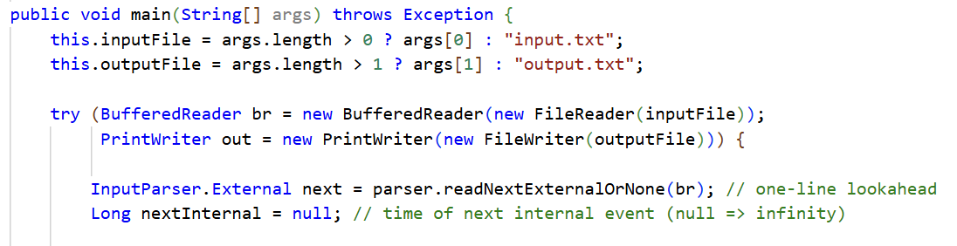
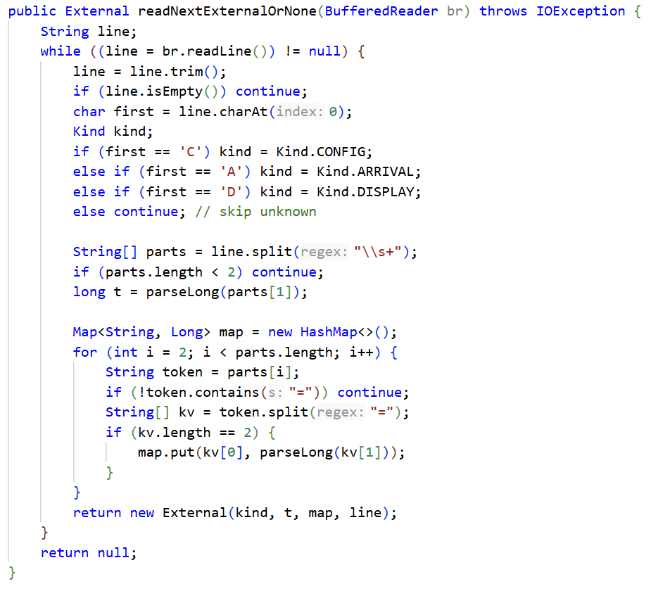
Required Data
Implement the read-process.
1. Implementation of a data structure for Jobs
2. Implementation of a data structure for Processes
3. Start reading the external event, assuming the internal event is null (infinity).
4. Declare the variable "current time".

Slide 7
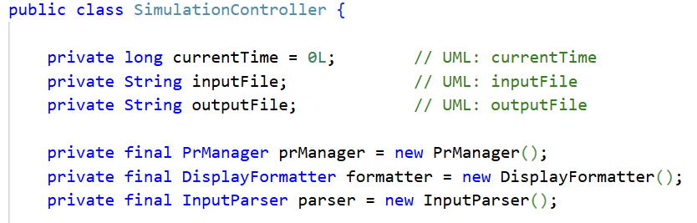
Required Data
Declare the variable "current time".
1. Implementation of a data structure for Jobs
2. Implementation of a data structure for Processes
3. Start reading the external event, assuming the internal event is null (infinity).
4. Declare the variable "current time".

Slide 8
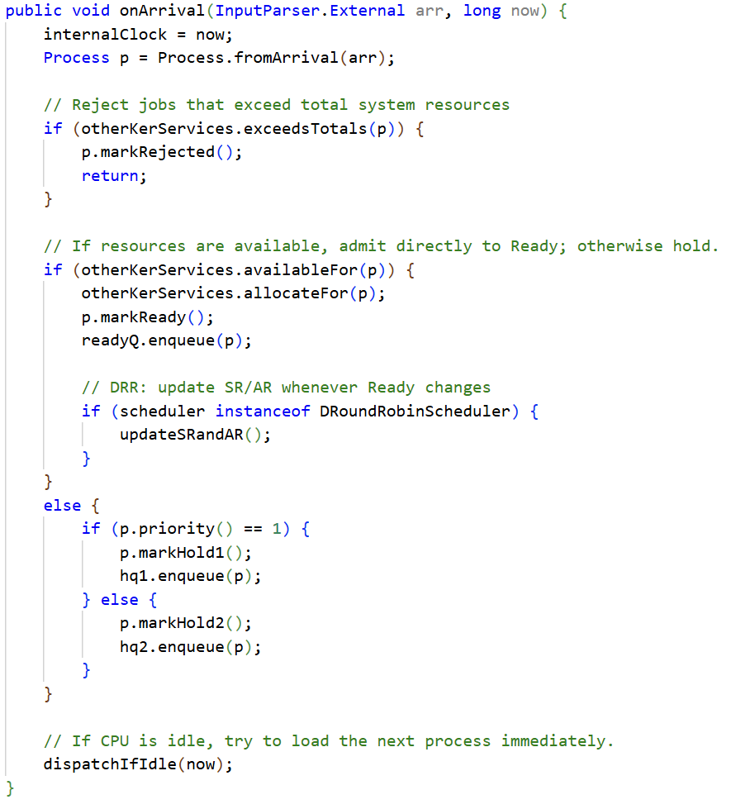
System requirements
1. If there is not enough total main memory or total number of devices in the system for the job, the job is rejected
2. If there is enough main memory and devices for the job, then :
• a process is created for the job,
• the required main memory and devices are allocated to the process, by otherKerService class
3. If there is not enough available main memory or available devices for the job, the job is put in Hold Queue 1, if priority=1, the job is put in Hold Queue 2, if priority=2
• the process is put in the Ready Queue.

Slide 9
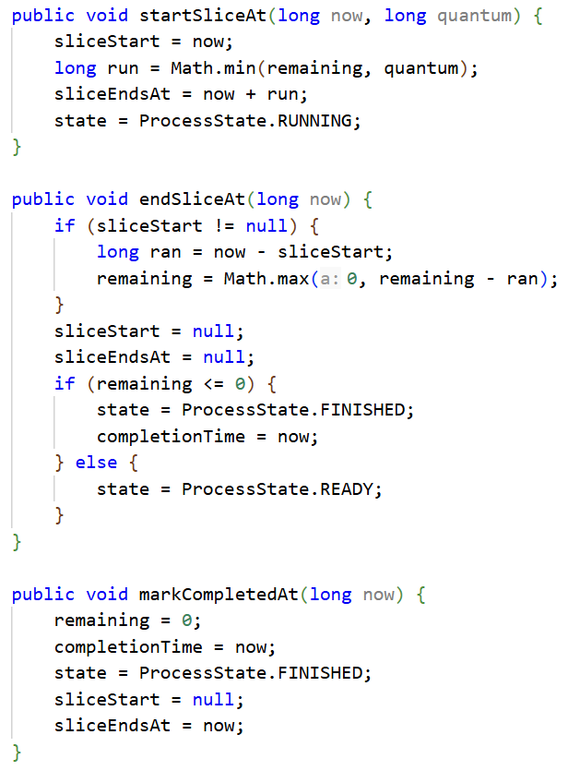
System requirements
Process Slice Handling - Termination States
Lifecycle Transitions
startSliceAt: Begins execution slice → updates sliceStart, sliceEndsAt, and sets state to RUNNING.
endSliceAt: Ends slice → calculates execution time, updates remaining, transitions to READY or FINISHED.
markCompletedAt: Fully completes job → sets remaining to 0, state to FINISHED, records completionTime.
Process Flow
Slice ends:
remaining <= 0 → Finished.
remaining > 0 → Ready.

Slide 10
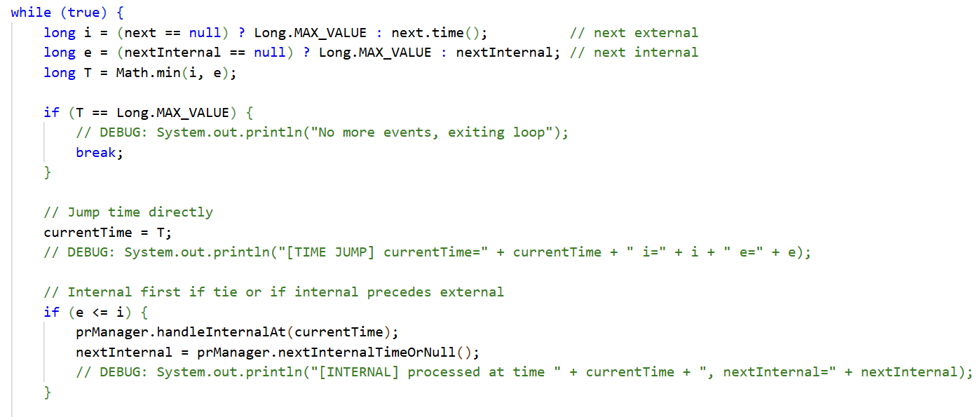
Implementation of events
Correct next event time computation and current time
1. Correct next event time computation .
2. "current time" must always be advanced to the time of the next event by a single assignment. (The variable cannot be "stepped" by a fixed increment until it reached the time of the next event.)
3. A display event is external event
4. Read command from the input file is an external event
5. Handle all internal events before external
6. The end of a time slice is an internal event.

Slide 11
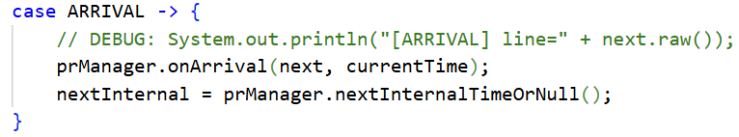
Implementation of events
Arrival Event
1. Correct next event time computation .
2. "current time" must always be advanced to the time of the next event by a single assignment. (The variable cannot be "stepped" by a fixed increment until it reached the time of the next event.)
3. A display event is external event
4. Read command from the input file is an external event
5. Handle all internal events before external
6. The end of a time slice is an internal event.

Slide 12
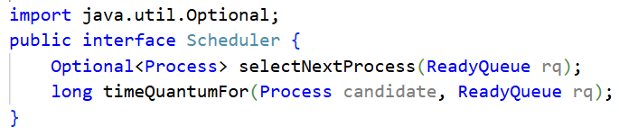
Implementation of events
Scheduler Interface
Scheduler Interface provides a common structure for all scheduling strategies.
selectNextProcess(ReadyQueue rq) Picks the next process from the Ready Queue.
timeQuantumFor(Process candidate, ReadyQueue rq) Gives the time slice (quantum) that the selected process gets — whether it’s a fixed quantum (Static RR) or one that changes (Dynamic RR).

Slide 13
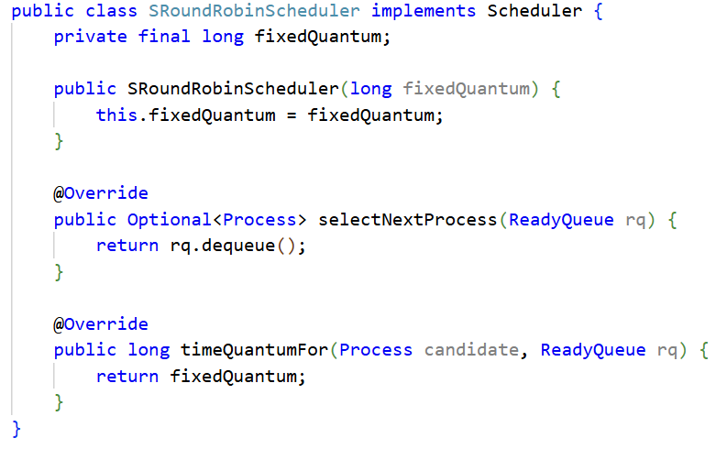
Implementation of events
Static Round Robin
SRR (Static Round Robin) Scheduler
SRR uses a fixed, unchanging time quantum for every process in the Ready Queue.
Quantum rule (as required): timeQuantum = 10 + TeamNumber.
Since TeamNumber = 7 → Static Quantum = 17 ms.
The constructor SRoundRobinScheduler(long fixedQuantum) stores this value (e.g., 17) in fixedQuantum.
selectNextProcess(ReadyQueue rq) simply calls rq.dequeue(), so the next process is always taken from the front of the Ready Queue → the queue behaves like a normal FIFO queue.
timeQuantumFor(Process candidate, ReadyQueue rq) always returns fixedQuantum, so every process gets exactly 17 ms when it reaches the CPU.
After its 17 ms slice finishes:
If the process is NOT done → it is re-enqueued at the end of the Ready Queue.
If the process has finished → it is removed and no longer scheduled.

Slide 14
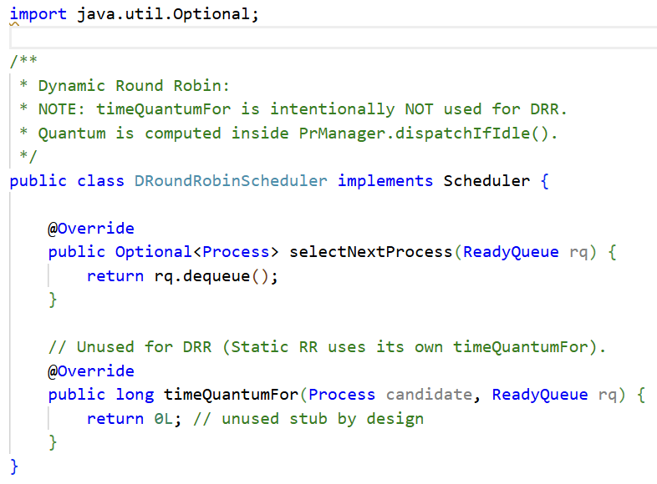
Implementation of events
Dynamic Round Robin
DRR (Dynamic Round Robin) Scheduler
DRR doesn’t use a fixed, constant quantum.
Instead, the time slice is recomputed every time the CPU becomes idle, based on the current processes in the Ready Queue.
In the code, DRoundRobinScheduler.selectNextProcess() just does rq.dequeue(), so the next process is always taken from the front of the Ready Queue (FIFO order).
The method timeQuantumFor(...) is not used for DRR → it returns 0L only as a stub. The real quantum calculation happens in PrManager.dispatchIfIdle().

Slide 15
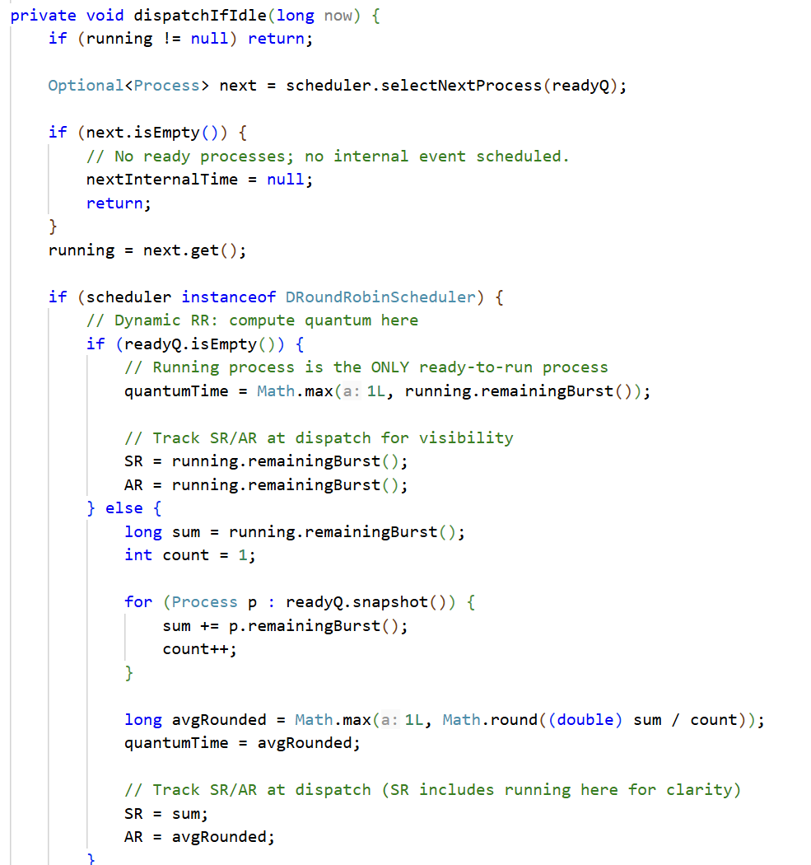
Implementation of events
Selecting next process by dispatch-if-idle function
Checks if CPU is busy - returns immediately if a process is already running
Gets next process - asks the scheduler to pick from the ready queue
Handles empty queue - if no processes ready, clears next event time
Calculates time quantum differently based on scheduler type:
-Dynamic Round Robin: Computes quantum based on average remaining burst times
-Static RR: Uses fixed quantum from scheduler
Starts process execution - sets when the process begins and when its time slice ends

Slide 16
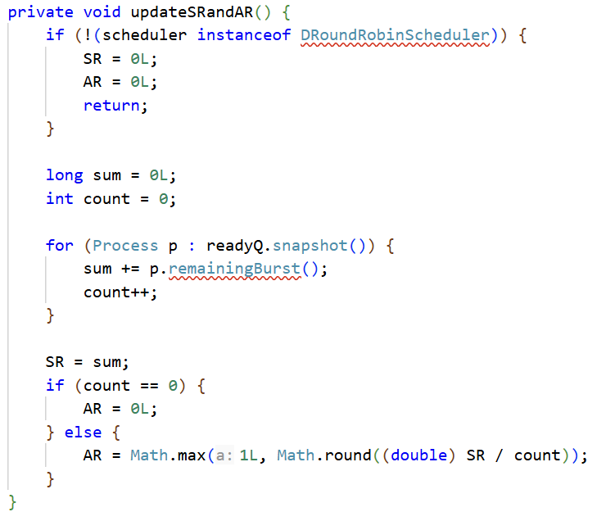
Implementation of events
Updating Sum of Remaining bursts and Average Remaining burst
For other schedulers: Sets both SR and AR to 0 (not applicable)
For Dynamic RR:
-Calculates SR: Sums up the remaining burst times of all processes in the ready queue
-Calculates AR: Divides SR by the number of processes to get the average, ensuring it's at least 1

Slide 17
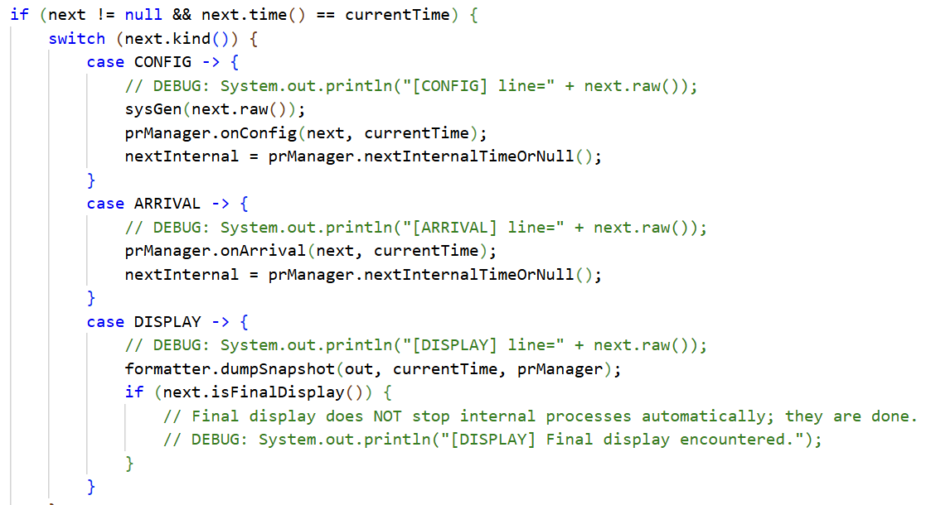
Implementation of events
Display Event
1. Correct next event time computation .
2. "current time" must always be advanced to the time of the next event by a single assignment. (The variable cannot be "stepped" by a fixed increment until it reached the time of the next event.)
3. A display event is external event
4. Read command from the input file is an external event
5. Handle all internal events before external
6. The end of a time slice is an internal event.

Slide 18
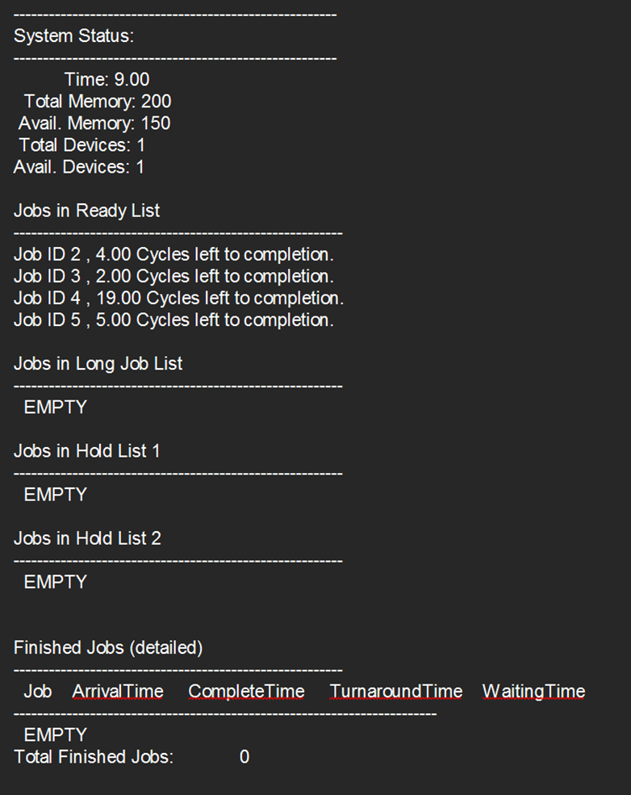
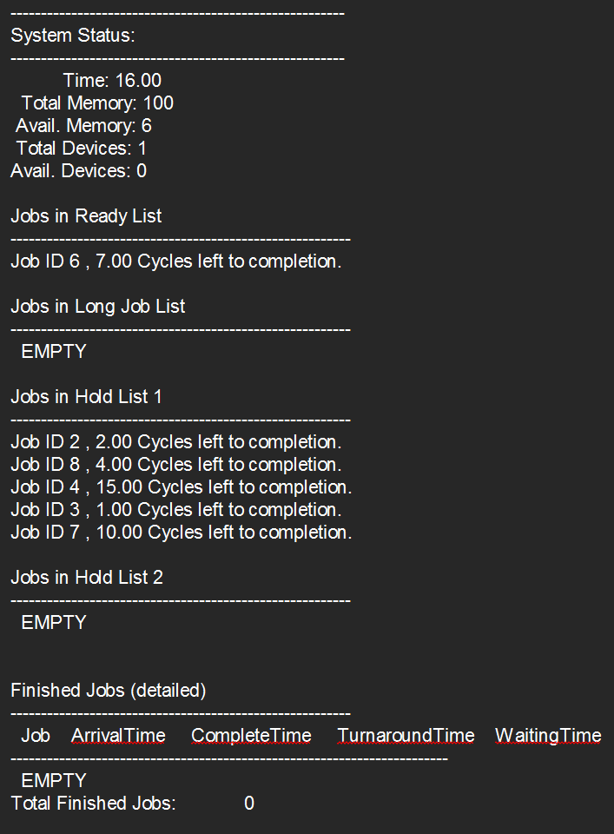
Output Specification
Current system status outputSRR (Display at 9 and 16)

Slide 19
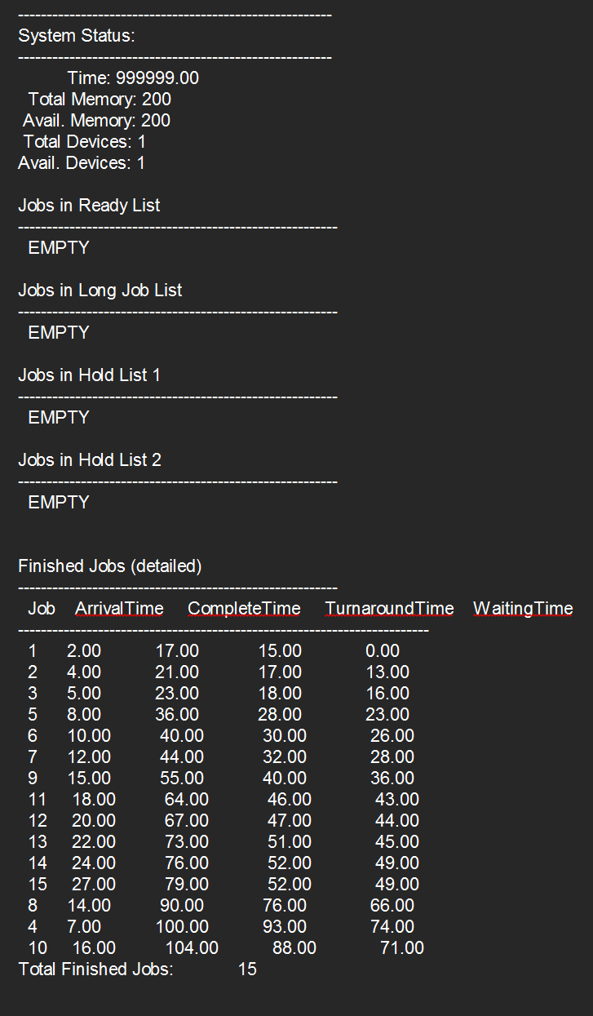
Output Specification
Current system status outputDRR (Display at 999999)

Slide 20
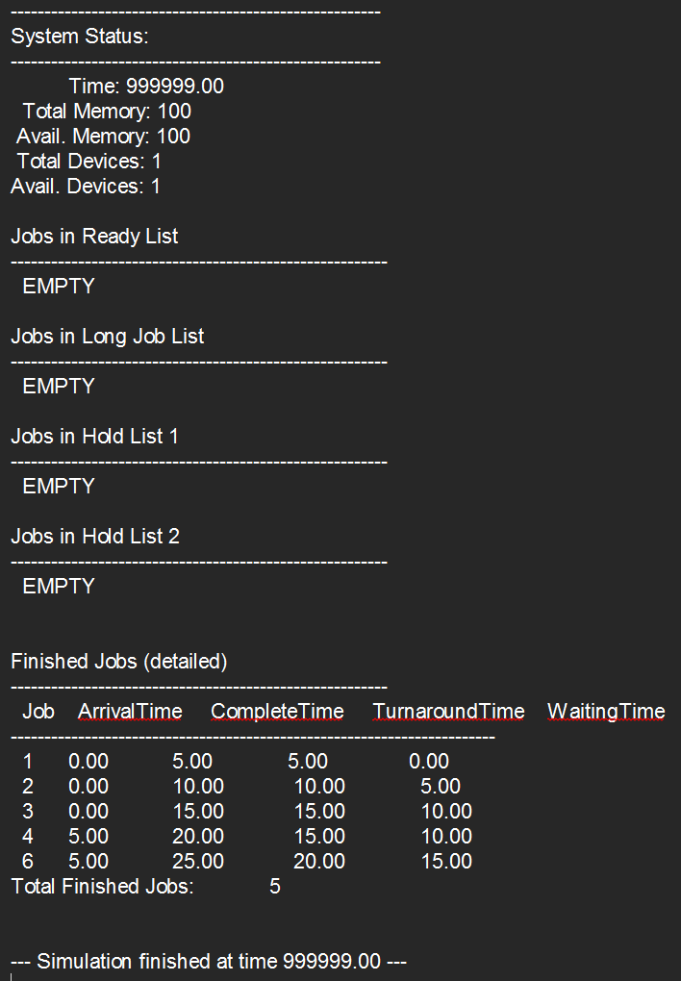
Output Specification
Current system status outputDRR1 (Display at 999999)

Slide 21
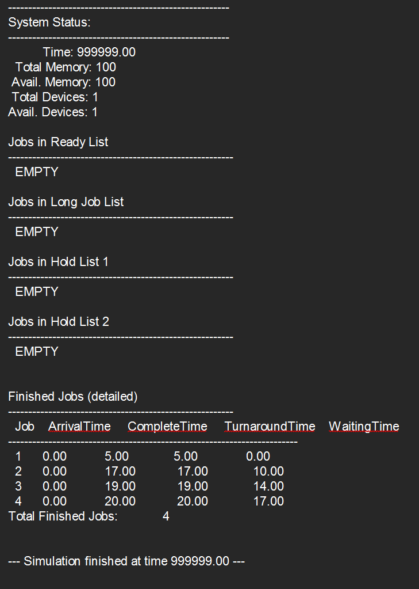
Output Specification
Current system status outputDRR2 (Display at 999999)

Slide 22
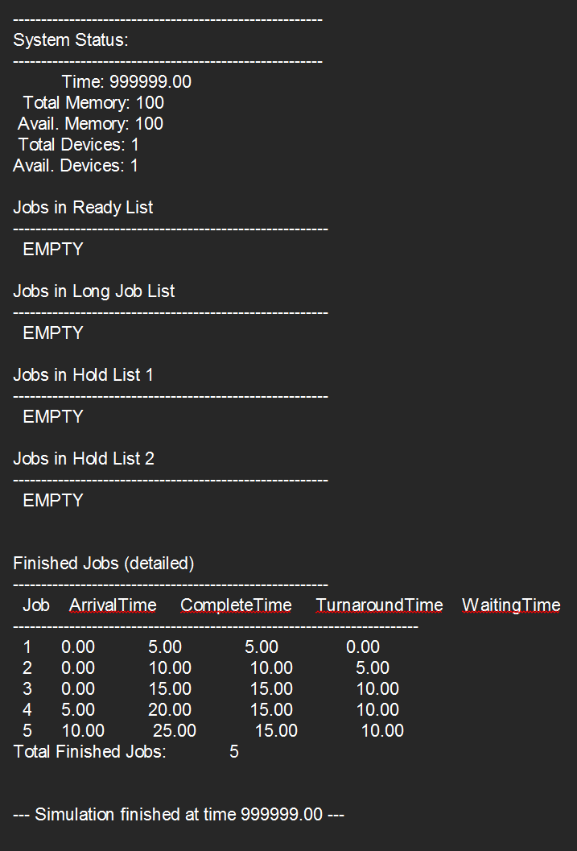
Output Specification
Current system status outputDRR3 (Display at 999999)

Slide 23
Team Members:
1. Mohammed Fahad Alharbi
2. Basel Al-Qurashi
3. Yasser Albogami

